Slide 1


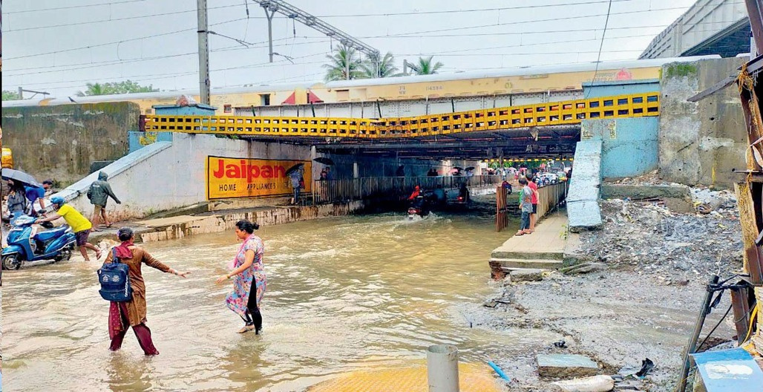
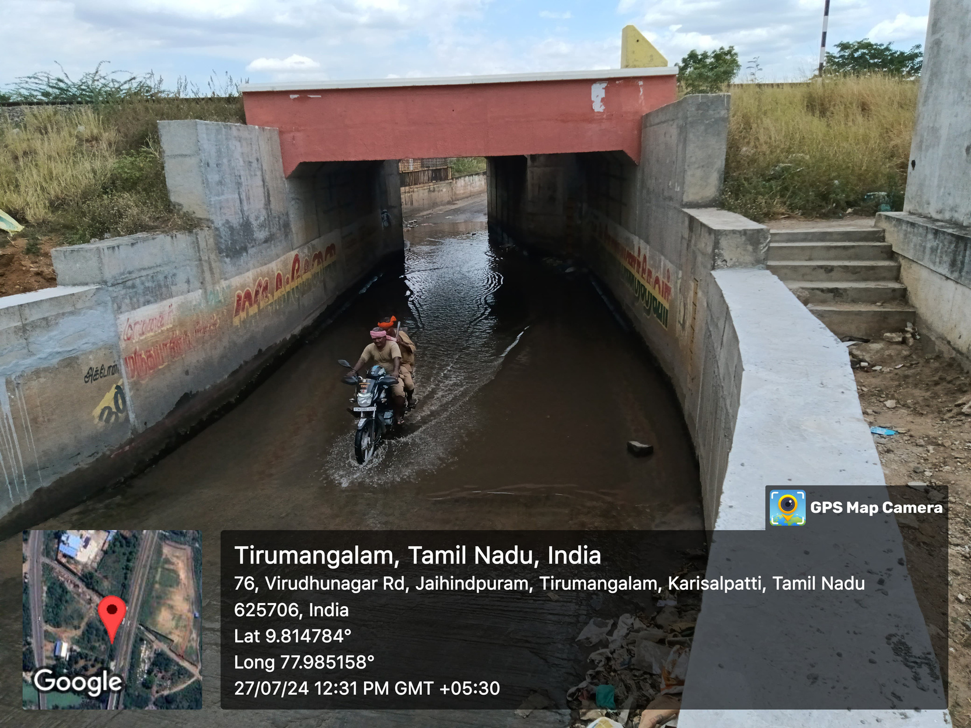


ENHANCED SUBWAY FLOOD MANAGEMENT SYSTEM USING IOT
Enhancing the Existing Model

Slide 2
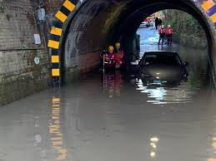
Introduction
The subways flooding is the major problem.
Affects both transportation and passengers.
The manual water removal process is delayed.
To overcome the barriers the automated stagnant water removal method is developed.
Send real-time notifications to both the public and authorized person.

Slide 3
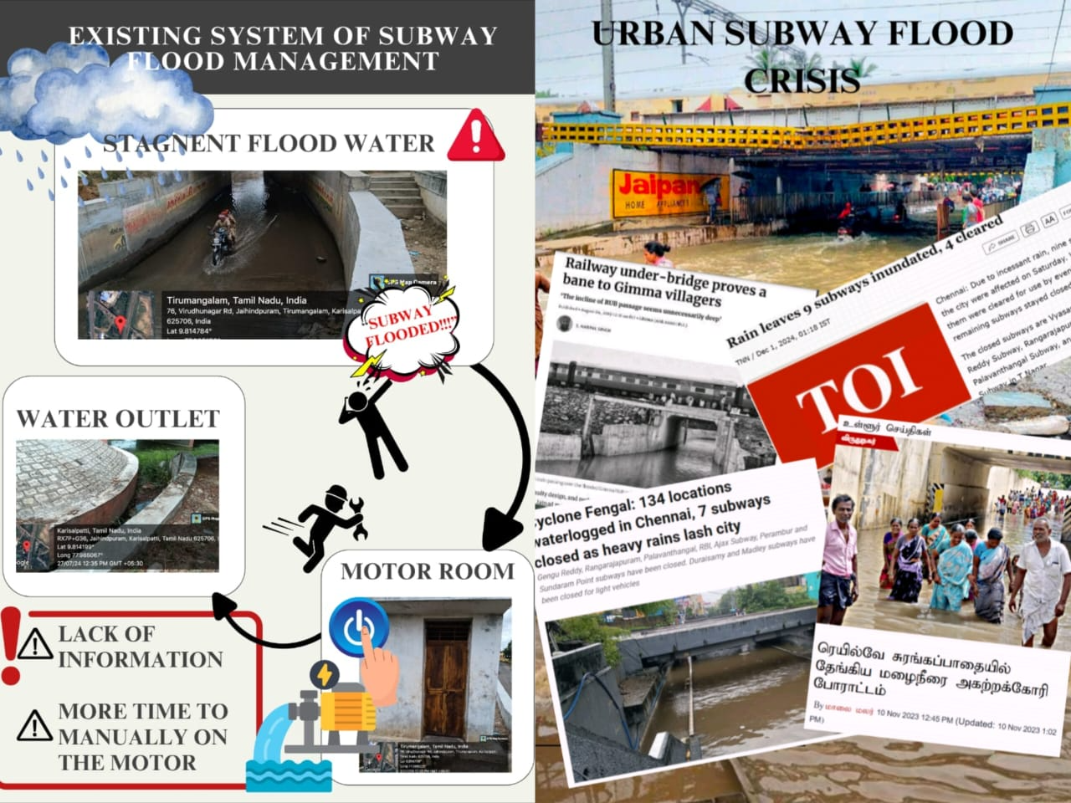

Slide 4

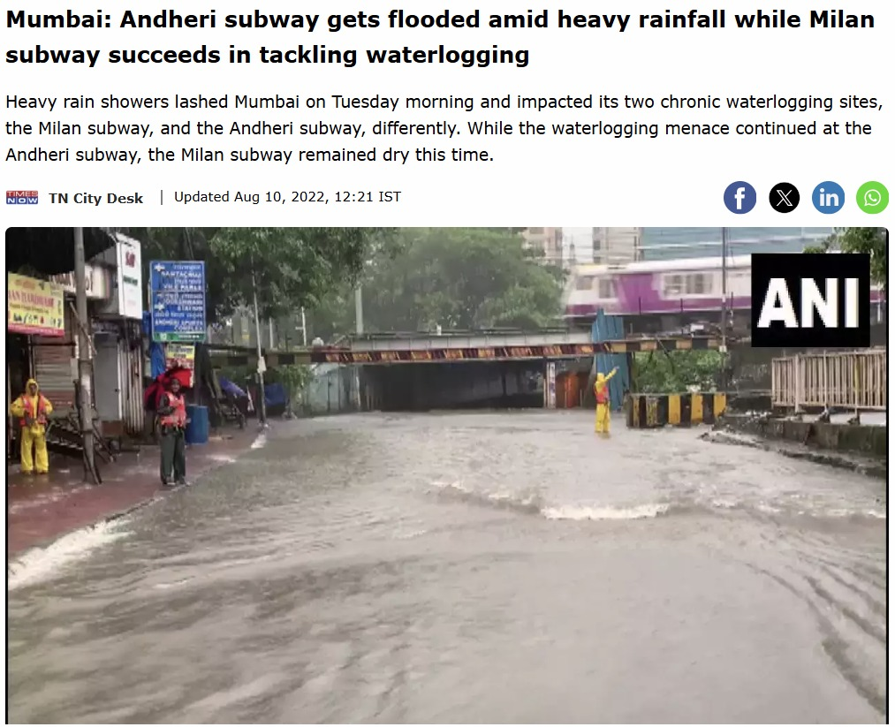
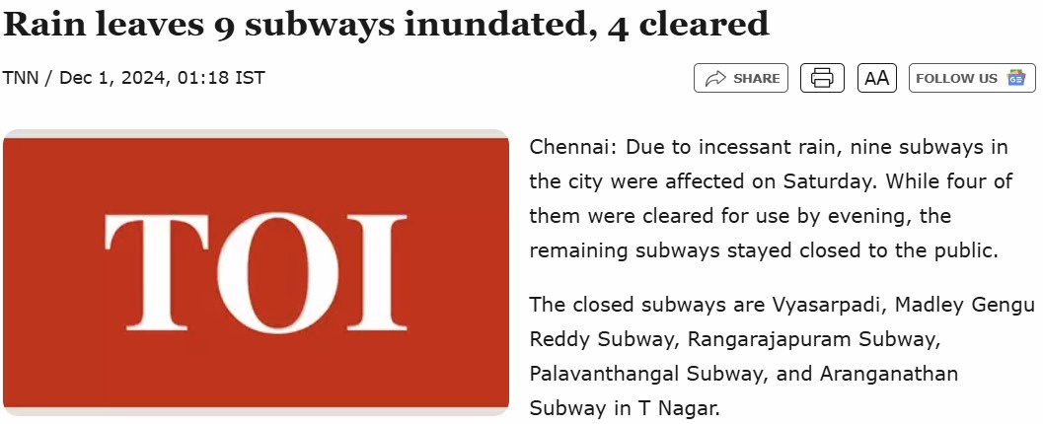

Impacts of Subway flood
Health

Slide 5
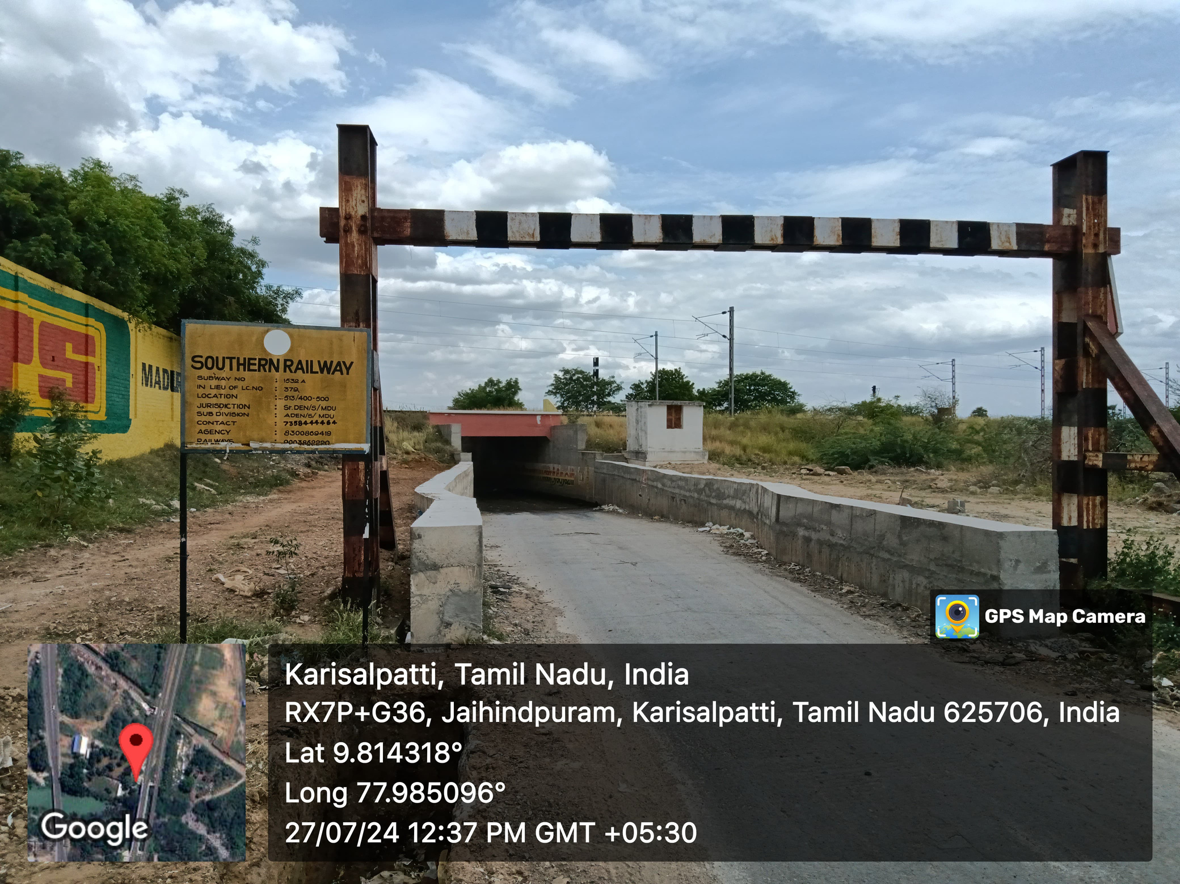

Impacts and solutions
Existing
Implementations
Insufficient real-time monitoring.
High Dependency on Manual Labor.
Lack of proper Drainage.
Disrupted Transportation.
TIMELY INTERVENTION
SWIFT EVACUATION
AUTOMATIC &MANUAL CONTROL
PUBLIC INTIMATION
NOTIFICATION ALERT

Slide 6
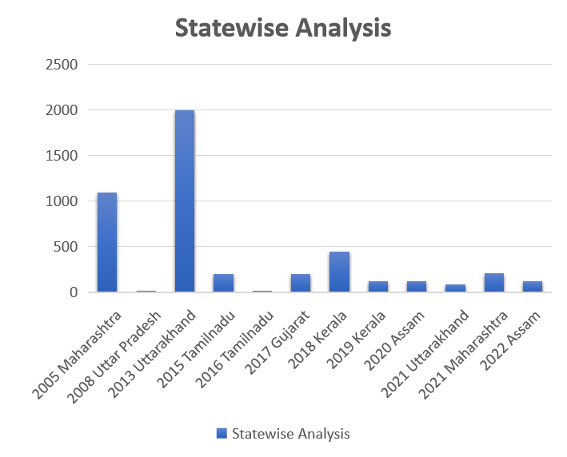
CASE STUDY
Govt initiated the drain and storm water systems
RUBs / Subways suffering flood
Essentials suffering due to Flood water
No initial prevention systems
Proposing an idea with preliminary safeguard with cost-effective system

Slide 7
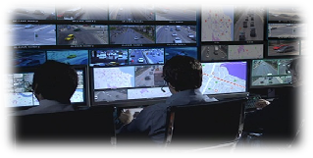
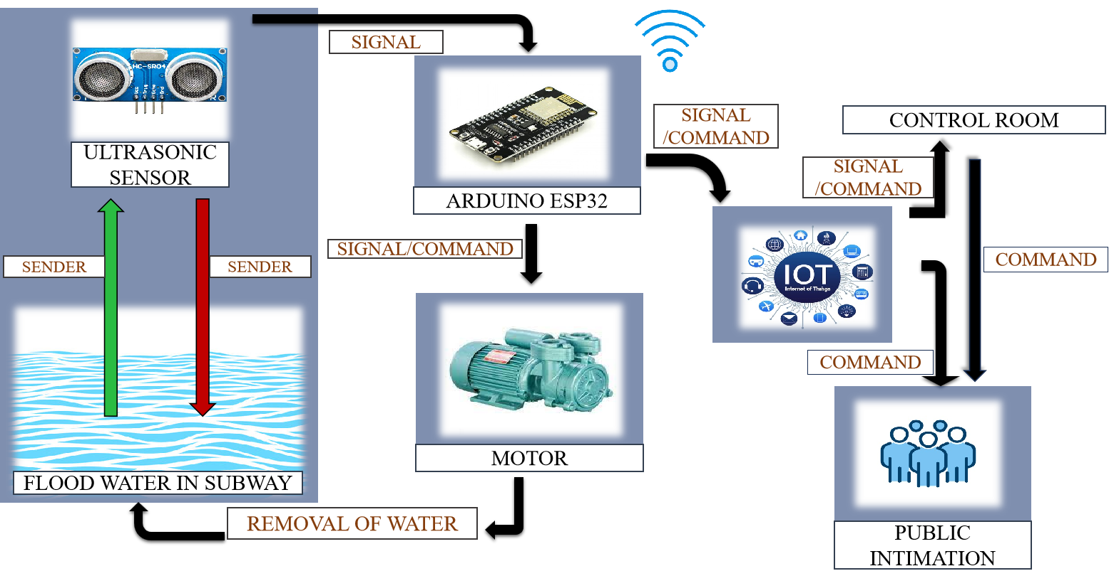


Effective Work Flow Model

Slide 8


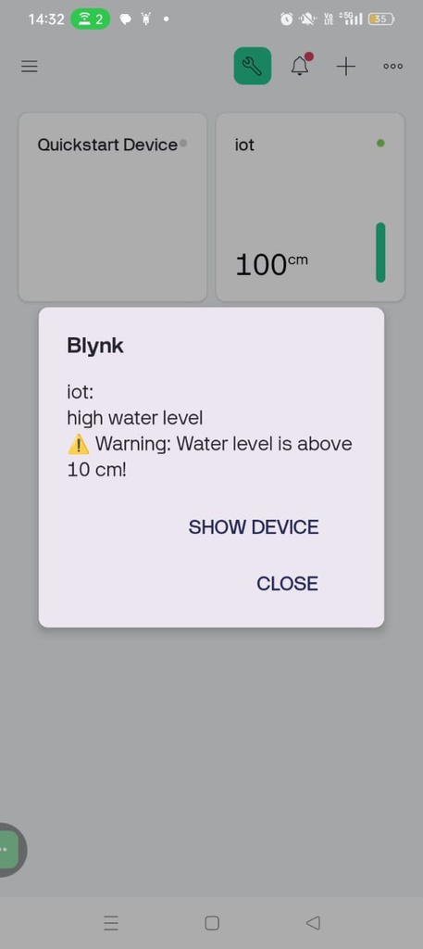




Notifying Authorized people
POP UP NOTIFICATION
NOTIFICATION WITH ALARMING SOUNDS AND
E-MAIL

Slide 9


NOTIFICATION SYSTEM
PUBLIC NOTIFICATION
ThingSpeak.
Water Level Monitering.
Indication alert on dashboard.
AUTHORIZED NOTIFICATION
Bylnk.
Water level monitering.
Motor on/off(manual&auto).
E-Mail notification.
Notification enabled with alarm sound.

Slide 10
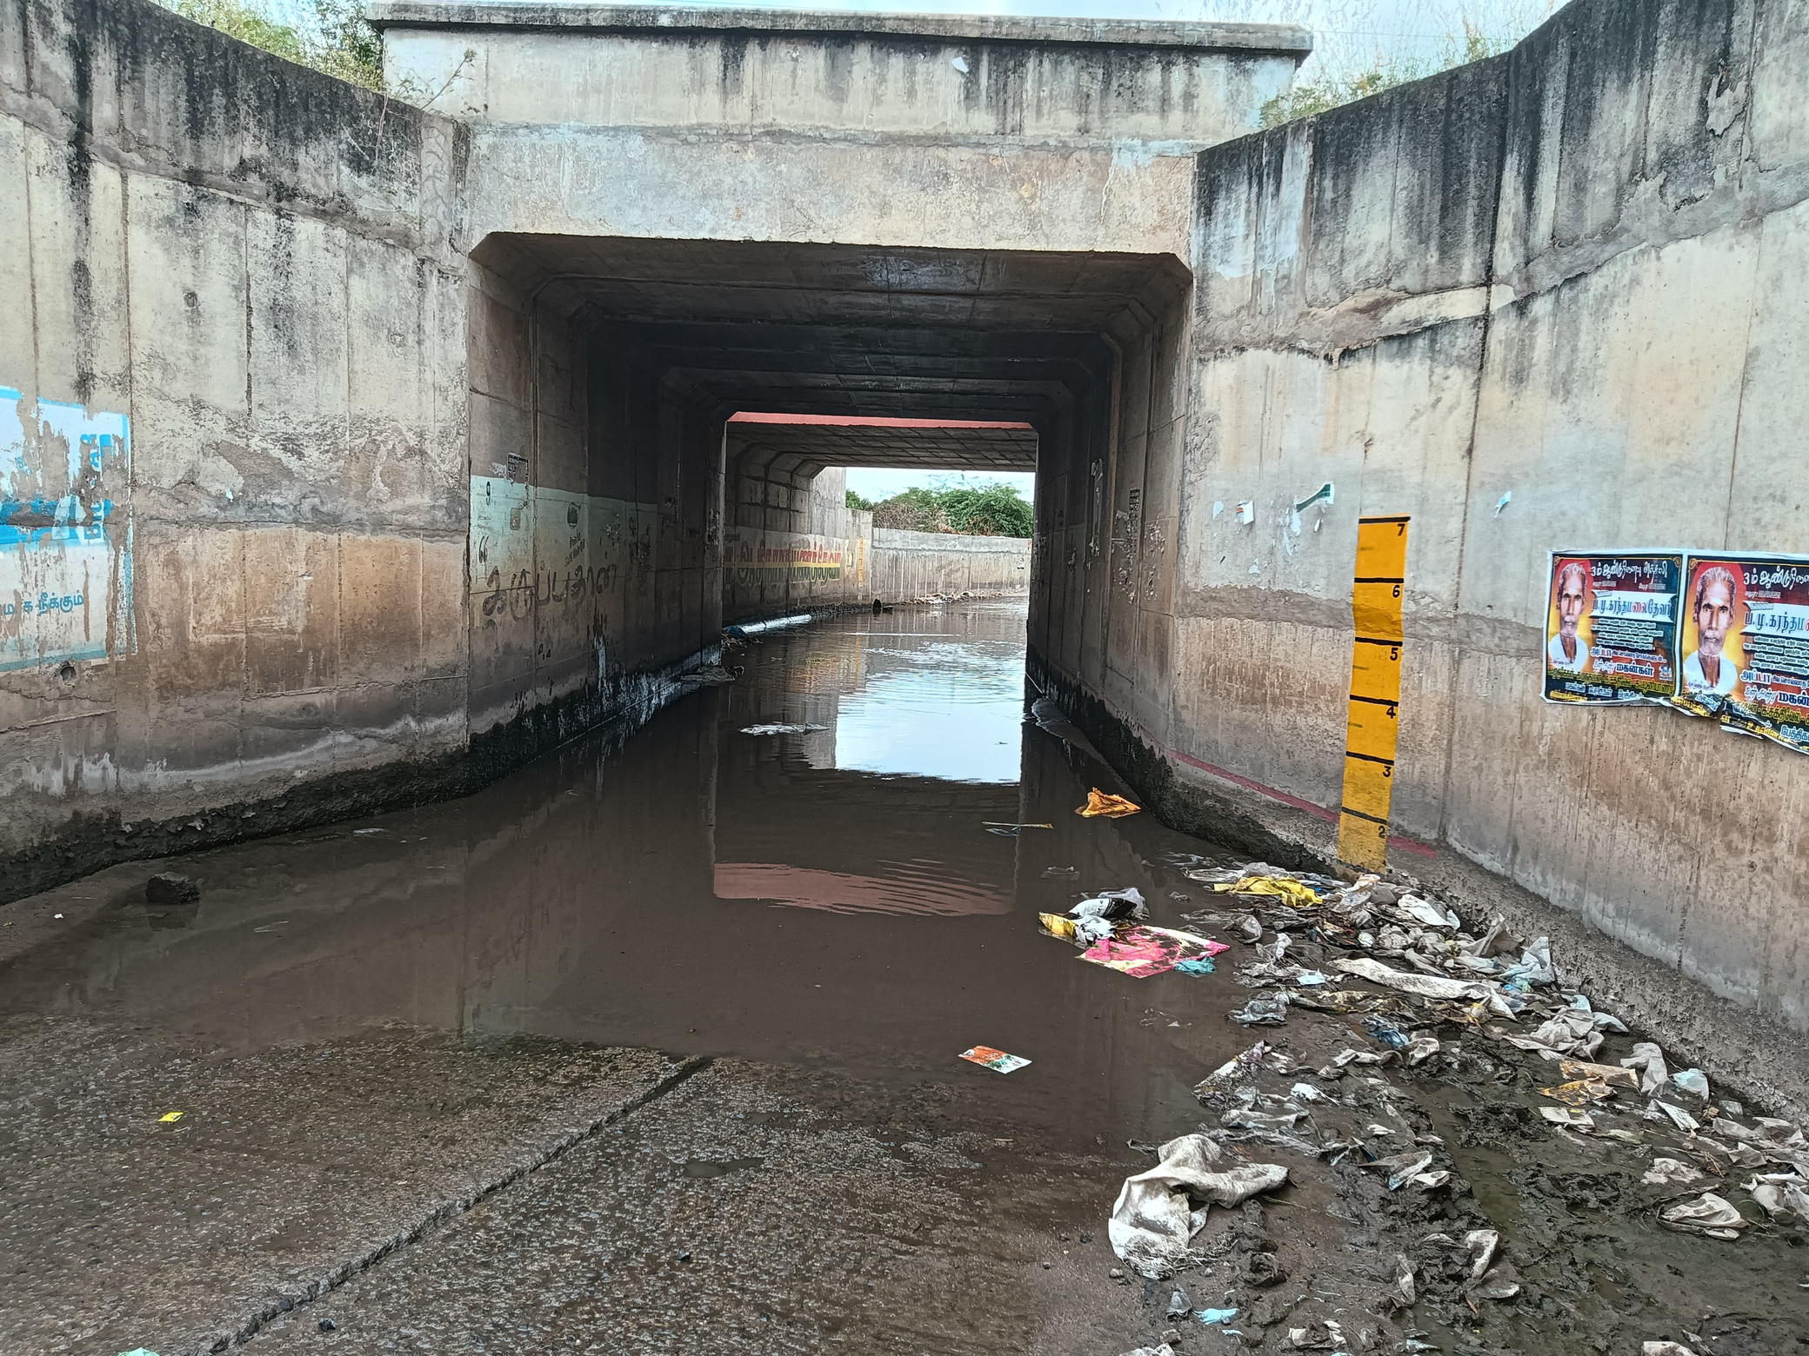
Future Scope
AI-Driven Flood Prediction:
Utilizing Artificial Intelligence (AI) and predict potential flood occurrences.
Implementing forecasting and preemptive measures for effective subway flood management.
Data Analytics for Risk Assessment:
Leveraging data analytics tools for comprehensive risk assessment and scenario analysis.
Integrating data-driven insights to devise adaptive strategiesfor subway flood mitigation and response.

Slide 11
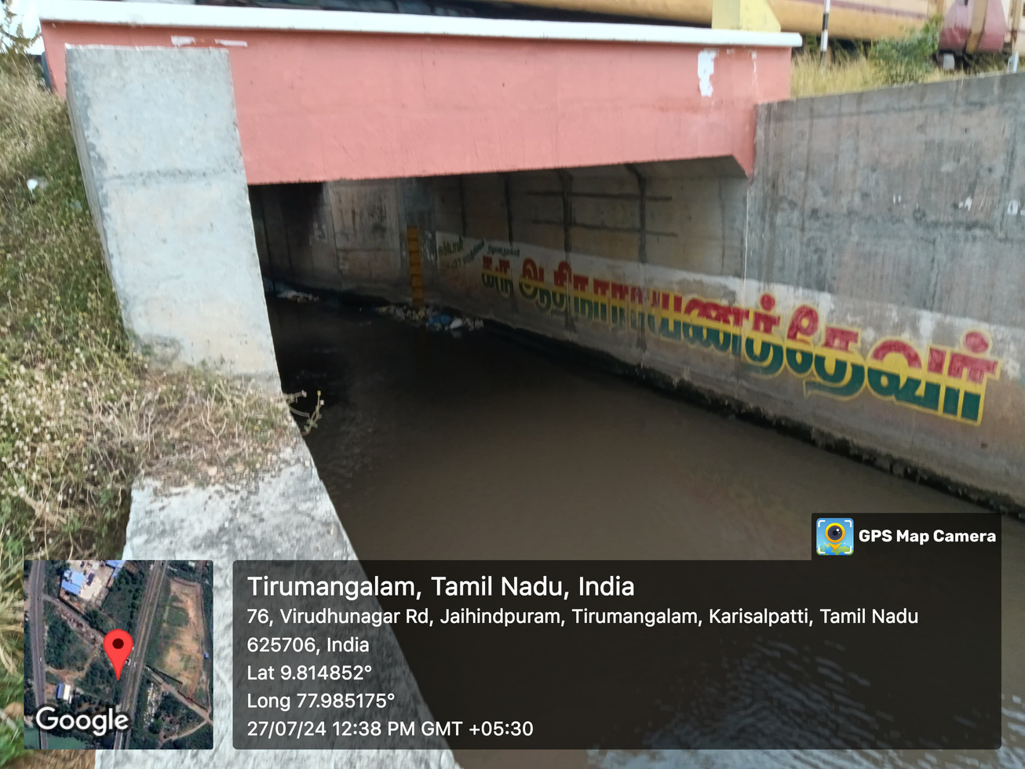
OUTCOMES
Efficient crisis response : Minimizing downtime during floods
Government collaboration : Partnering for widespread implementation
User-friendly impact : Real time monitoring accessible to the public
Timely intervention

Slide 12
BIBILOGRAPHY
https://www.thehindu.com/news/cities/chennai/several-subways- inundated/article33173280.ece
https://www.thehindu.com/news/national/tamil-nadu/great-escape-from-a-submerging-suv-in-a-chennai-subway-a-first-person-account/article67608687.ece
https://www.thehindu.com/news/cities/chennai/waterfall-effect-at- subway/article20512482.ece
https://www.hindustantimes.com/india-news/cyclone-michaung-subway- submerged-under-floodwater-in-chennai-as-heavy-rain-pounds-city-video- 101701686444152.html
National Disaster Management Guidelines: Management of Urban Flooding, A publication of the National Disaster Management Authority, Government of India, ISBN: 978-93-80440-09-5, September 2010, New Delhi.
https://images.app.goo.gl/fKi6Sadvdft8eSQS7Post-Sandy Flood Resiliency in NYC: How to Prevent Subway Systems from Increasing Storm Surges, Jessie Jing, Brown University, December 23, 2021

Slide 13
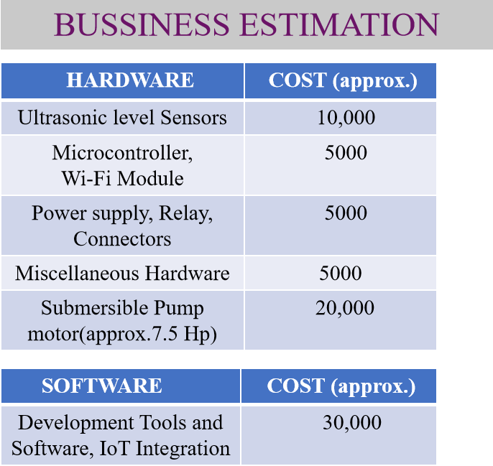

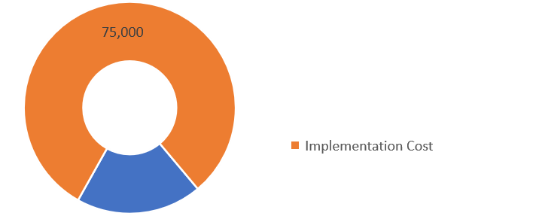
Total Implementation Cost – Rs.75,000

Slide 14
Lean Canvas
PROBLEM
Urban subway flood causes :
Prolonged waterlogging
Transit delays
Economic losses
Safety hazards
SOLUTION
An IOT system using closed environment with sensor system
Ultrasonic sensors
Water level sensor
An ESP32module
Blynk and ThingSpeak for remote control
Automated pump motor
CUSTOMER SEGMENTS
Municipal transit authorities
Urban developers
Emergency management agencies
Smart City planners
EXISTING ALTERNATIVES
Manual drainage
Passive flood barriers
Non-integrated Sensor systems
UNIQUE VALUE PROPOSITION
CHANNELS
Automation method
Real time monitoring system
Swift Evacuation
Minimal disruption
Timely Intervention
Government contracts
Public - private partnership
Pilot programs
Smart city tenders
COST STRUCTURE
REVENUE STRUCTURE
KEY MATRICS
Fixed Costs : Hardware/software development ,and IOT integration -Rs 30,000
Variable Costs : Production, Installation ,and maintenance - Rs 45,000 per unit
Licensing fees : Rs 20,000(per unit)
Service contracts : Rs 30,000(per unit)
Data subscription : Rs 15,000(per unit)
Government grants: Rs 15,000(per unit)
Projected manual reverse : Rs 80,000(after deployment)
>95% sensor accuracy
50% reduction in evacuation time
Decrease in subway downtime
Total Cost:75,000/unit

Slide 15

THANK YOU

